Slide 1
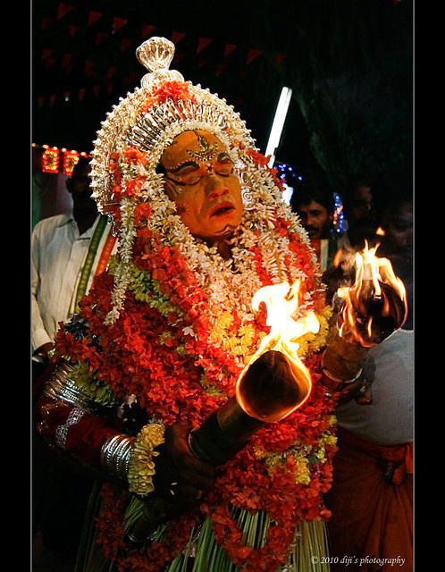
Quiz Time
Festivals of Tulu Nadu
How Well Do You Know the Festivals?

Slide 2


Instructions
Question Structure:
There are a total of 20 questions in the quiz.
For each correct answer, the team will earn 10 points.
For questions with two answers, each correct answer will earn the team 5 points.
Answering Protocol:
When your group knows the answer, raise your hand immediately.
The group that raises their hand first will get the opportunity to answer.
Each team will have only one chance to answer a question.
**Have fun!**

Slide 3



PART 1
Festive Quest

Slide 4


Q1
X is a festival marked by grand processions where a new Swamiji is ceremoniously handed over the responsibility of the temple administration, with traditional rituals, music, and dance. Y is the temple associated with this festival. Identify X and Y.

Slide 5


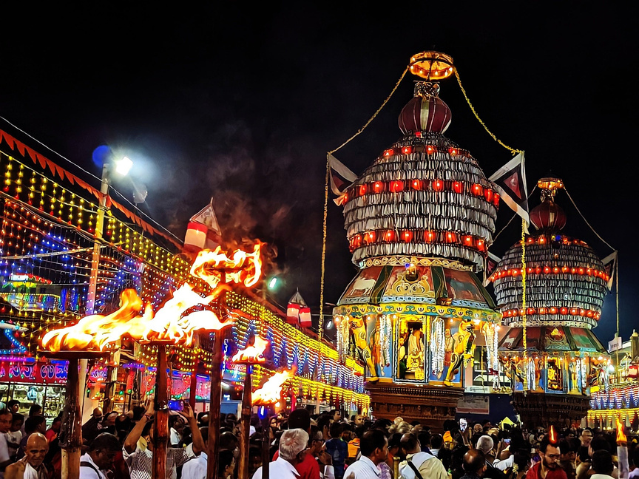
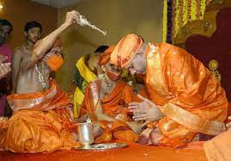
ANSWER
X is Paryaya , Y is Udupi Krishna Matha
Paryaya is a festival held every two years in Udupi where the management of the Krishna Temple is handed over to one of the eight mathas. Each time, a new Swamiji takes charge for two years, continuing a tradition that has been in place for over 700 years.
Dramatic irony

Slide 6


Q2
X is a major festival in Kerala that includes the famous Vallamkali boat races and celebrates the mythical return of King Mahabali. What is X?

Slide 7
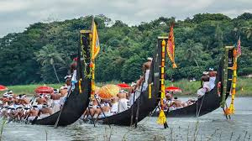
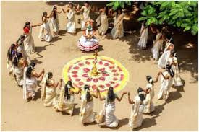
ANSWER
X is Onam
Onam is a major festival in Kerala celebrated in August or September to mark the homecoming of the mythical King Mahabali. The festival includes boat races (Vallamkali), colorful floral designs (Pookalam), a grand feast (Sadya), and traditional dances. It symbolizes unity, prosperity, and cultural heritage.

Slide 8

Q3
X is a traditional drink consumed on an empty stomach for its medicinal properties during Y, a festival celebrated on the new moon day in the Aati month of the Tulu calendar. Identify X and Y.

Slide 9
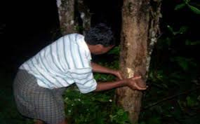
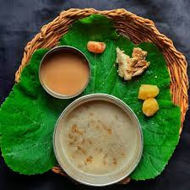
ANSWER
X is Kashaya , Y is Aati Amavasye
“Paale ketteda kashaya” is a herbal drink consumed during Aati Amavasye. It cleanses the digestive system, detoxifies the body, and boosts immunity.
Dramatic irony

Slide 10
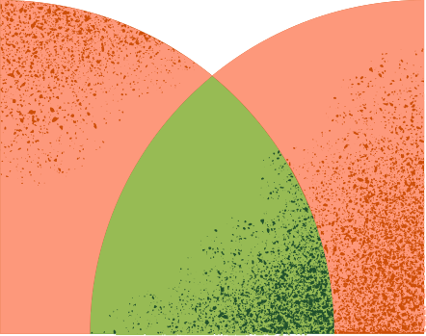
Q4
X is a New Year and harvest festival of Tulu Nadu. Identify X

Slide 11
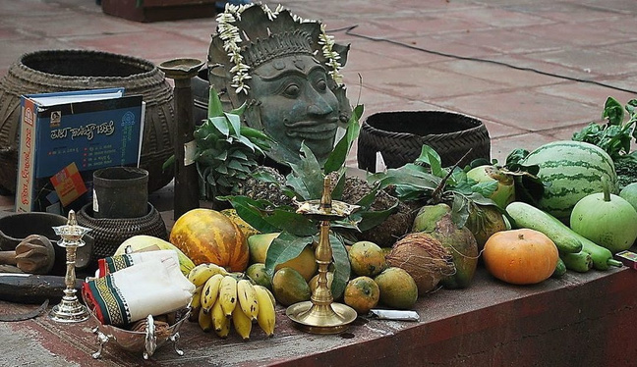
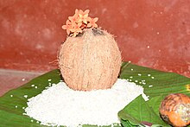
ANSWER
X is Bisu Parba
“Bisu Parba” is a harvest festival in coastal Karnataka celebrated in April. It marks the start of the agricultural year with offerings of the first harvest, such as paddy, to deities. The festival features community feasts and rituals, emphasizing gratitude and unity.

Slide 12
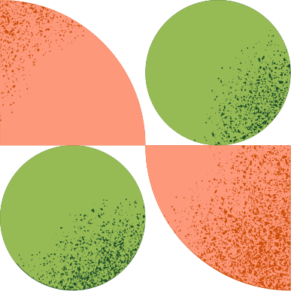
Q5
X is a major Hindu festival that signifies the end of the winter solstice and the beginning of longer daylight hours. This festival also marks the Sun's entry into a specific zodiac sign. What is X?

Slide 13
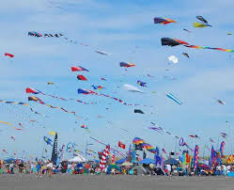
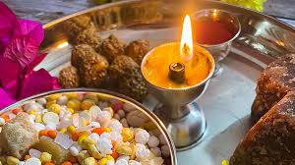
ANSWER
X is Makara Sankranti
Makara Sankranti is a Hindu festival marking the Sun's entry into Capricorn, symbolizing the end of winter and the start of longer days. Celebrated across India, it involves regional customs like preparing sweets, taking holy dips in rivers, and honoring the harvest season.

Slide 14


Q6
X is an event in the life of Jesus where He entered Jerusalem, and the crowd welcomed Him by laying palm branches and shouting "Hosanna"(save us). Christians remember this event each year at the beginning of Holy Week. What is X?

Slide 15
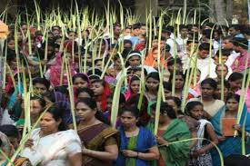
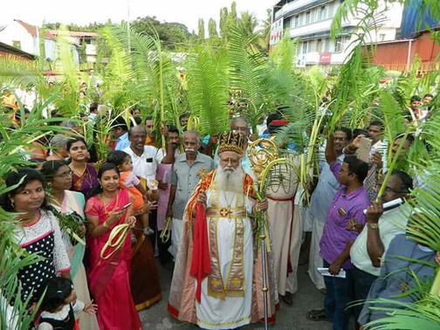
ANSWER
X is Palm Sunday
Palm Sunday is a Christian observance that marks the start of Holy Week, leading up to Easter. It commemorates Jesus' entry into Jerusalem, where the crowd welcomed Him with palm branches and shouted "Hosanna." It is a key part of the Easter celebrations.

Slide 16
Q7
X is a major festival that concludes the month of fasting, known for its distinctive prayers, the practice of Zakat al-Fitr, and feasts featuring traditional sweets like 'Sheer Khurma.’ What is X?

Slide 17
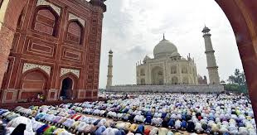
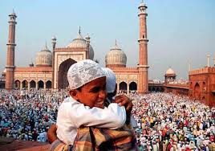
ANSWER
Eid ul-Fitr
Eid ul-Fitr celebrates the end of Ramadan with prayers, festive meals, and community gatherings. A key element is Zakat al-Fitr, a required charitable donation given before the Eid prayer to ensure everyone can join in the celebrations.

Slide 18
Q8
X is a new moon day in the Margashira month(Dec-Jan), considered auspicious for taking a holy dip in the sea or sacred rivers in Karnataka. Identify X.

Slide 19
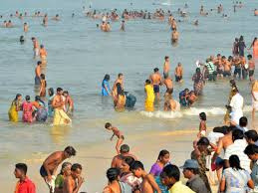
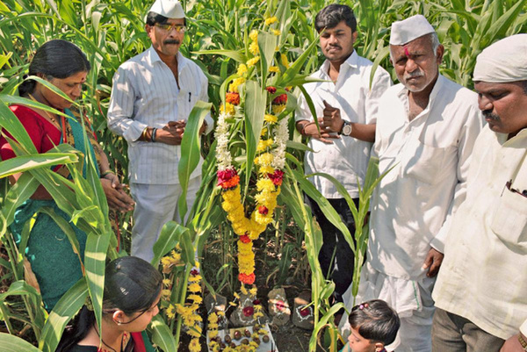
ANSWER
Yellu Amavasye (Ellamvasya)
Yellu Amavasya is a traditional festival celebrated in the Tulu Nadu region of Karnataka during the Margashira month. It occurs on the new moon day (Amavasya) and involves offering sesame seeds (yellu) to the land and nature.

Slide 20
PART 2
Picture Parade
Identify the festivals based on the images provided

Slide 21

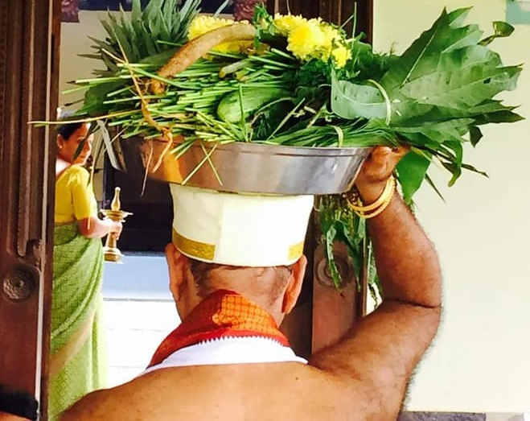

Q9
From the image, identify the traditional festival in Tulu Nadu that features rituals, community gatherings, and traditional dishes.

Slide 22
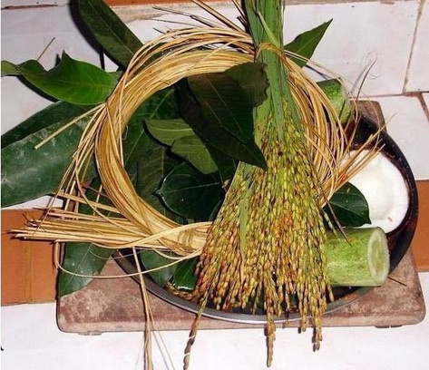
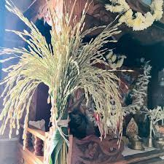
ANSWER
Koral Parba
Koral Parba, celebrated in Tulu Nadu before the first harvest, involves collecting the first corn ears, offering them with prayers, and preparing a special meal called "Puddar da Vanas." Local Christians also celebrate a similar event, Monti Fest, on September 5th.

Slide 23


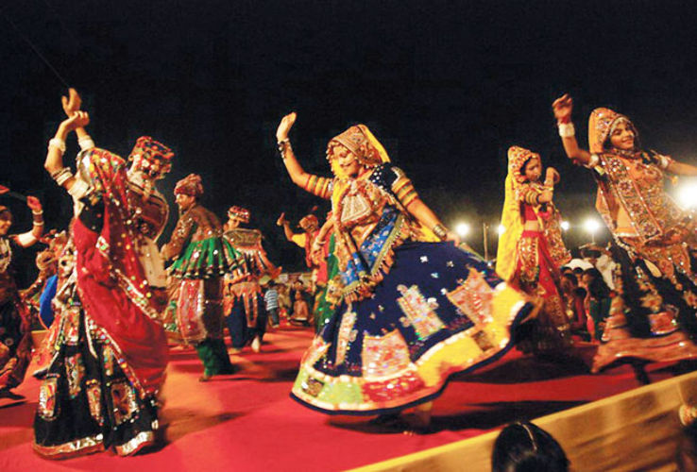
Q10
Based on the image, identify the dance form X and the festival Y during which it is performed.

Slide 24
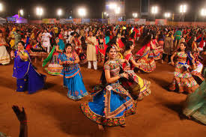
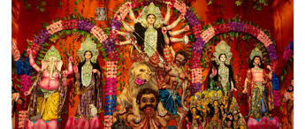
ANSWER
X is Garba , Y is Navratri
Navratri is a nine-night Hindu festival honoring Goddess Durga, marked by fasting, prayers, and rituals. Garba is a vibrant dance performed during Navratri, celebrating the goddess with energetic, circular movements.

Slide 25


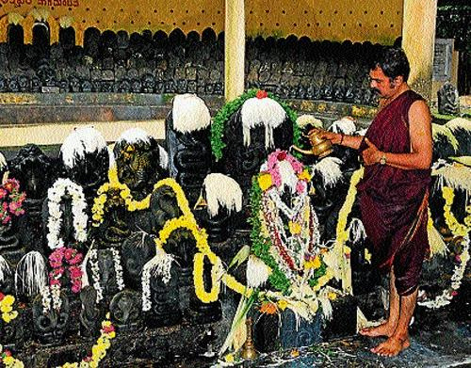
Q11
From the image, identify the festival

Slide 26
ANSWER
Nagara Panchami
Nagara Panchami in Tulu Nadu is celebrated on the fifth day of the lunar month of Shravana (July-August). The festival involves visiting temples, offering prayers, and performing rituals to honor snake deities. It reflects reverence for snakes, seen as protectors and symbols of prosperity. Local customs and practices vary across villages.

Slide 27
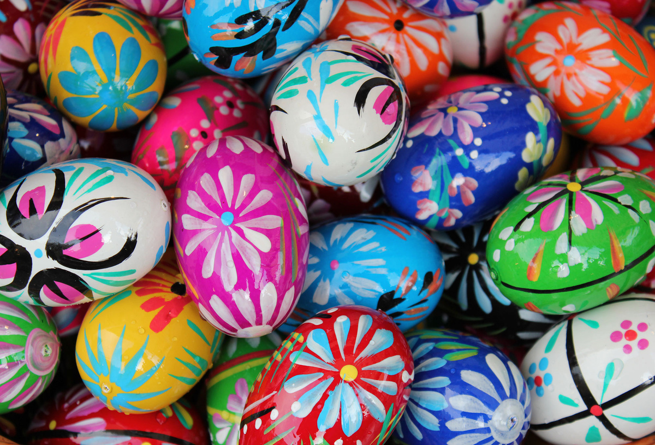
Q12
Based on the image, Identify the festival

Slide 28
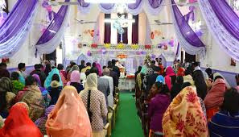
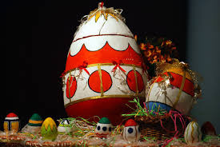
ANSWER
Easter
Paschal Eggs symbolize new life and resurrection, representing the empty tomb of Jesus Christ and are often decorated and enjoyed during Easter. Easter, which celebrates Jesus' resurrection and marks the end of Lent, features special church services, festive meals, and traditions like egg decorating and egg hunts.

Slide 29
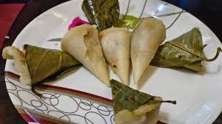
Q13
Based on the dish shown in the picture, identify the dish and the festival during which it is traditionally prepared.

Slide 30
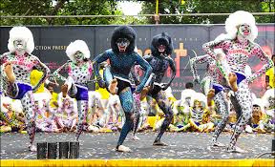
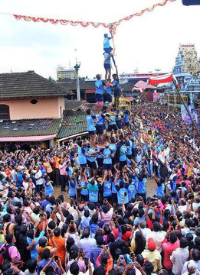
ANSWER
Chilmi Da Adde and Ashtami(Krishna Janmashtami)
“Chilmi Da Adde” is a traditional rice cake made with rice, coconut, and jaggery, steamed in leaves. Prepared during Krishna Janmashtami (Ashtami) in Tulunadu, it is enjoyed as a festive treat. Its cultural significance lies in its role as a symbolic offering to Lord Krishna, reflecting Tulunadu's rich culinary heritage and devotion during the festival.

Slide 31
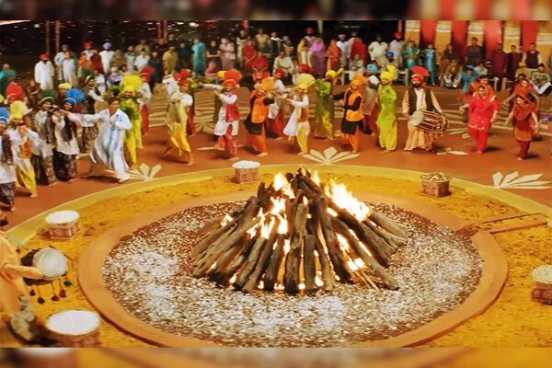
Q14
Based on the image, Identify the festival

Slide 32
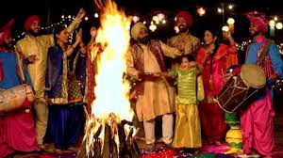
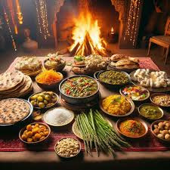
ANSWER
Lohri
Lohri is a Punjabi festival celebrated on January 13, marking the end of winter and the harvest of sugarcane. It features a bonfire, traditional dances, and festive foods like makki di roti and sarson da saag.

Slide 33
PART 3
Celebration Chronicles
Based on the festival name provided and explain the cultural or historical significance of why the festival is celebrated.

Slide 34
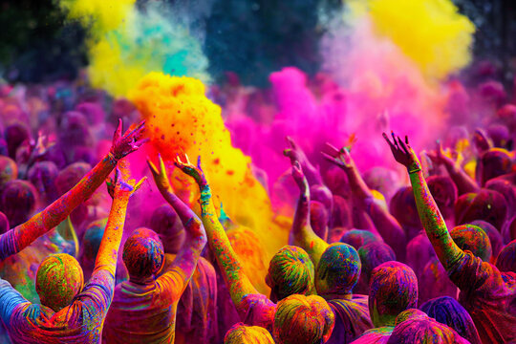
Q15
HOLI

Slide 35
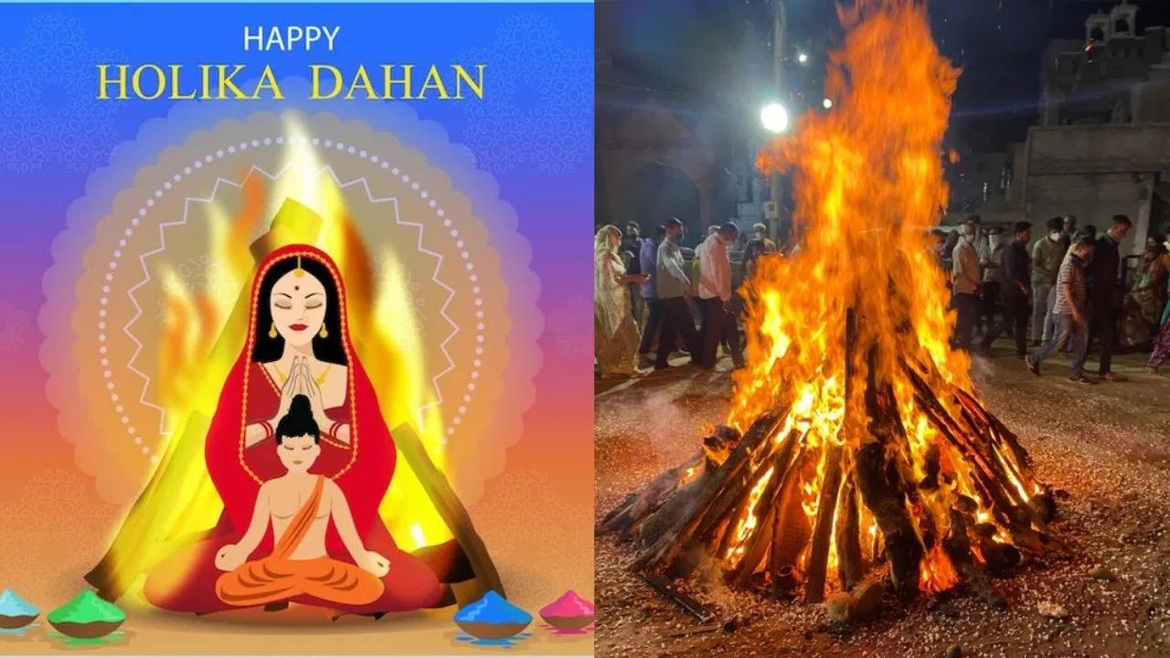
ANSWER
Holi celebrates the victory of Prahlad, a devotee of Lord Vishnu over the demoness Holika. It also celebrate the divine love between Lord Krishna and Radha.

Slide 36
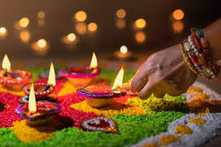
Q16
Deepavali (Diwali )

Slide 37
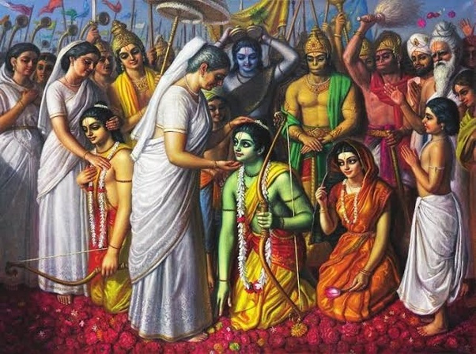
ANSWER
Deepavali(Diwali) is celebrated to mark the return of Lord Rama to Ayodhya after his victory over the demon king Ravana.

Slide 38
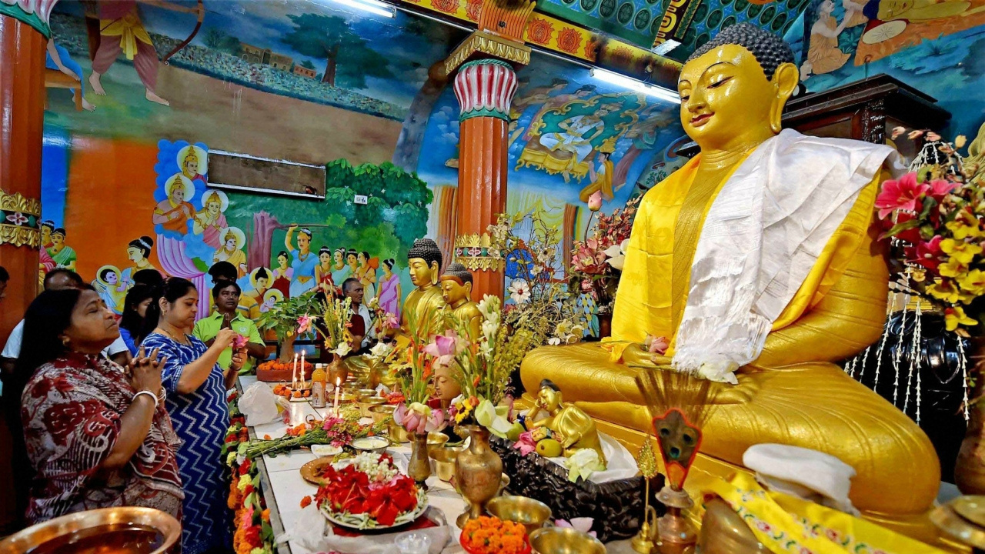
Q17
Buddha Purnima
(Vesak)

Slide 39
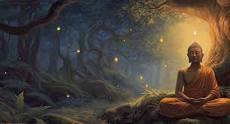
ANSWER
Buddha Purnima is celebrated to commemorate the birth, enlightenment (Nirvana), and death (Parinirvana) of Gautama Buddha.

Slide 40
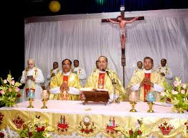
Q18
good friday

Slide 41
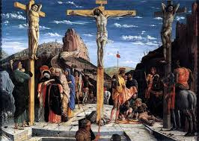
ANSWER
Good Friday is observed to commemorate the crucifixion and death of Jesus Christ.

Slide 42
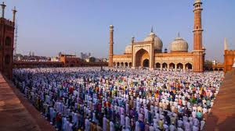
Q19
Eid al-adha (Bakrid)

Slide 43
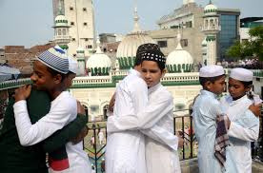
ANSWER
Eid al-Adha commemorates the willingness of Prophet Ibrahim (Abraham) to sacrifice his son Ismael in obedience to God

Slide 44
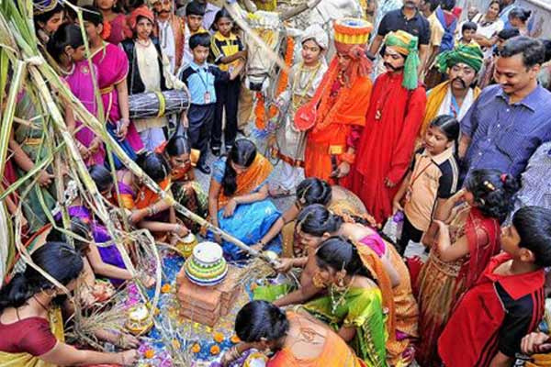
Q20
Yugadi
(ugadi)

Slide 45
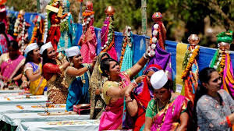
ANSWER
Yugadi(Ugadi) marks the New Year in the Hindu Calendar, belived to be when Lord Brahma began creating the universe.

Slide 46

Thank You

